Slide 1

ALI HILMI UYSAL
SCRAPING

Slide 2
Agenda:
About Data
Bussiness Questions & Findings
Further Research

Slide 3

> 400.000 Projects
Data on
5.000 Projects Scraped
28 attributes
US Only!

Slide 4

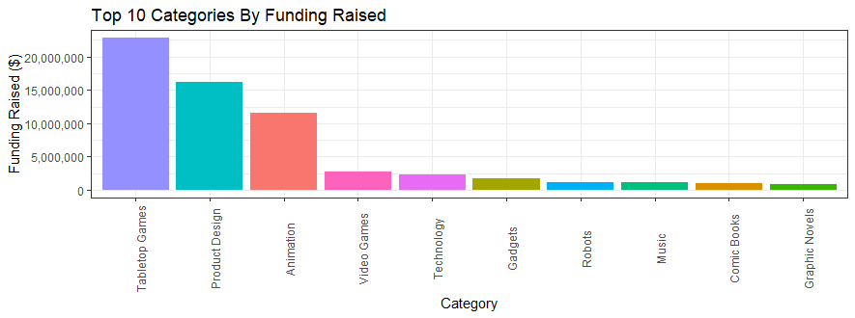










by numbers

Slide 5
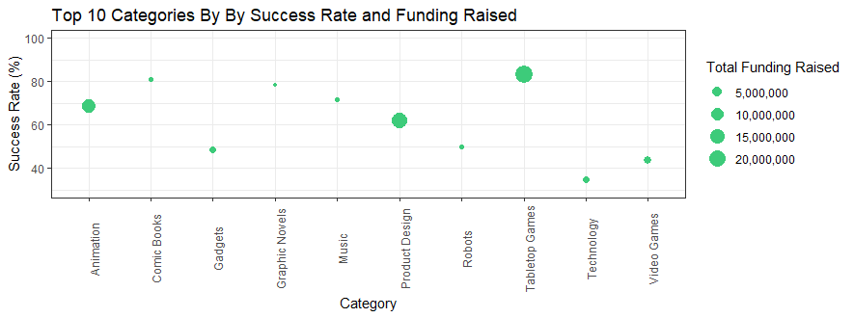
by numbers

Slide 6
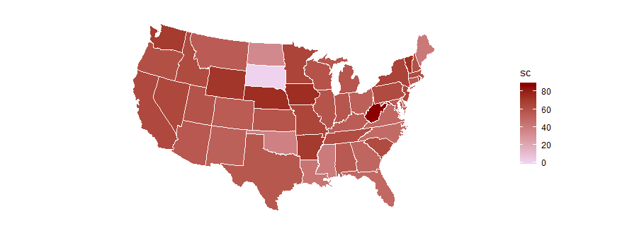
Success rate by states

Slide 7
Which factors are affecting the success of KICKSTARTER Projects?

Slide 8
$ 9.190
$ 43.085
AVERAGE FUNDING GOAL
$ 33.857
$ 1.529
AVERAGE FUNDING RAISED
74.49
1.64
AVERAGE # of COMMENTS
7.34
1.42
AVERAGE # of UPDATES
14.60
5.48
AVERAGE # of PROJECT IMAGE
SUCCESSFUL
UNSUCCESSFUL

Slide 9
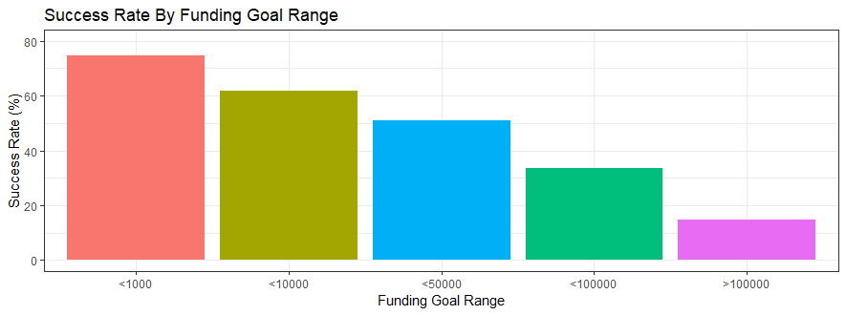
The higher the goal range of a project, the lower the success rate is!

Slide 10
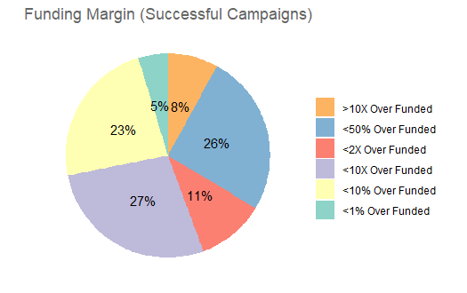
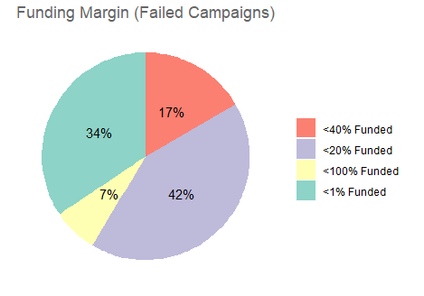
More than 90% of failed projects can not even reach 50% of the goal range!

Slide 11
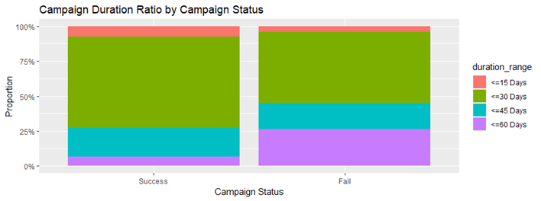
Projects with 60 days of campaign duration are more likely to fail!

Slide 12
Further Research
Success Factors by Category
Success Factors by Country

